Slide 1

Notes:
GOOD MORNING

Slide 2
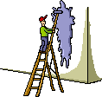
TOPICAL FLUORIDES

Slide 3
Topical fluorides

Slide 4
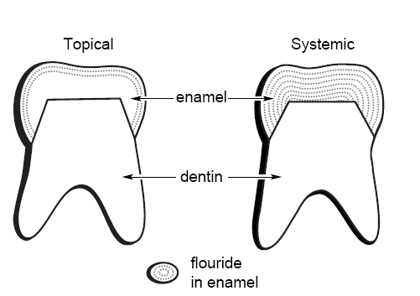
Contents
Introduction
Mechanism of action of Fluoride
Indications for the use of Topical fluorides
Factors affecting uptake of fluoride
- Condition of the tooth
- Formulation of the agent
- Application procedure
Professionally applied fluorides
-solutions
– Gels
– Varnishes

Slide 5
Contents
Self applied fluorides
- Dentrifices
– Rinses
– Gels
– Tooth picks
– Floss
– Chewing gums
Recent advances
Conclusion
References.

Slide 6
Introduction

Slide 7
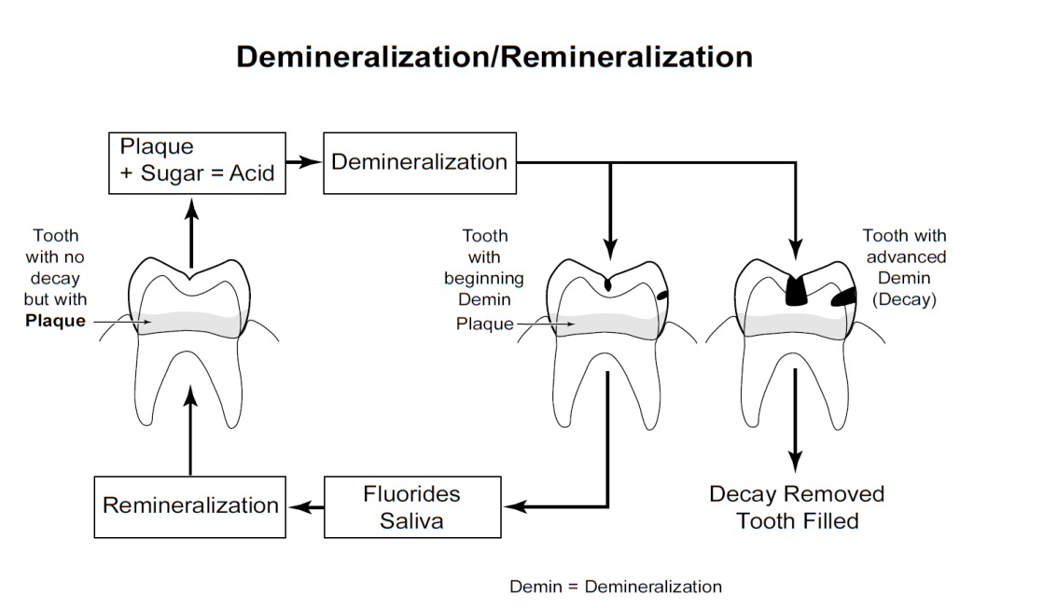
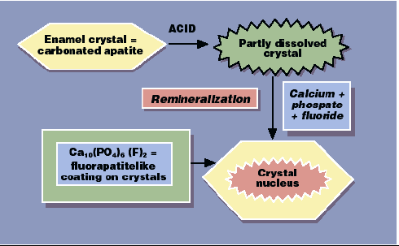

Slide 8
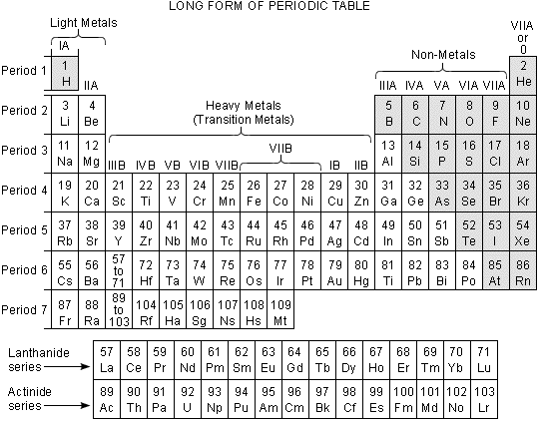
Fluoride chemistry & occurrence -
-Greek “floris”- destruction;Latin “fluor”- flow or flux
-Symbol- “F”
-Atomic no.- 9
-Atomic weight- 18.99
-It is a pale yellow, corrosive gas, which react with practically all organic and inorganic substances

Slide 9
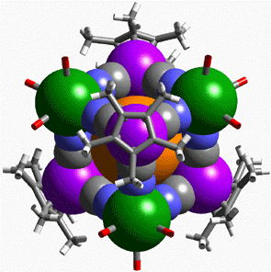
Chemistry-
Reasons for high reactivity:-
  Most electronegative of all elements
  Small size of atom
  High electron affinity
  Small bond length

Slide 10
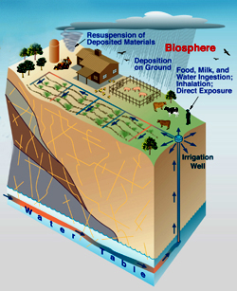
Occurrence-
-17th in order of abundance of all elements
-Constitutes about 0.032% in earth’s crust
-Fluoride containing minerals
    Fluorspar (CaF₂) - 48.8%
    Cryolite (Na₃AlF₆) - rare
    Fluorapetite Ca₁₀(PO₄)₆F₂- 3.8%
Topical fluorides strengthen teeth already present in the mouth, making them more decay resistant.

Slide 11

Fluoride in hard tissue…
Teeth:-
  -Deposition occurs in successive stages.
  Initial deposition – organic and mineral phases are laid down
  Pre-eruptive maturation phase-before eruption
  Post eruptive maturation and aging period
  -Dentin contains 4 times more than enamel
  -Fluoride concentration not uniform
  initial stages is higher than on completion
  -Primary teeth, less fluoride concentration than permanent teeth

Slide 12
Fluoride in hard tissue…
Fluoride concentration in the outer enamel (2micrometer)-
1700ppm-non fluoridated areas (0.1ppm)
2200 to 3200ppm- optimally fluoridated areas (1ppm)
4800ppm- 5 to 7ppm
 | Permanent teeth | Primary teeth
Non-fluoridated areas Fluoridated areas | 1100ppm 2200ppm | 670ppm 950ppm

Slide 13
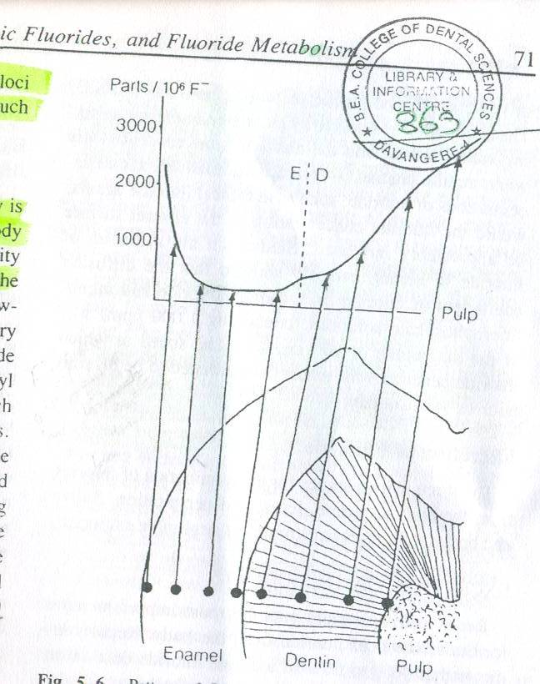
Fluoride in hard tissue…
F concentration in newly erupted teeth- higher in incisal than cervical margin
Diffusion of F in enamel
-NaF and monoflurophosphate(100pmm)-10⁻⁹cm²/sec
Speed at which F penetrates in enamel
-38 micrometer/ hour (186micrometer/ day)
Concentration in dentin:-
more than enamel
apatite crystals are smaller
surface area and capacity to take is much larger

Slide 14
Fluoride in hard tissue…
Fluoride concentration in Cementum:-
  Higher than any skeleton or dental tissue
  Tissue is very thin
  Near the tissue surface- accessible to fluoride present in blood
  Increases with age

Slide 15
Fluoride supplementation
Systemic
Topical
Professional application
Water fluoridation
School water fluoridation
Milk fluoridation
Dietary fluorides
Salt fluoride
Fluoride in sugar
Self application

Slide 16
TOPICAL FLUORIDES
Professional
Self
Solutions
NaF SnF₂ APF NH₂F
Gels
Varnish
  Dentrifices
Rinses
Gels
Chewing gum
Tooth pick
Floss

Slide 17
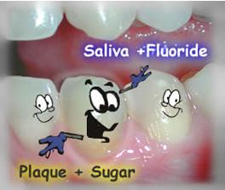
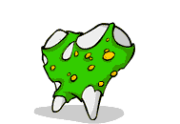
Mechanism of action of fluoride

Slide 18
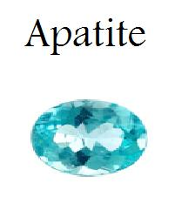
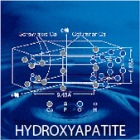
Systemic effects of fluoride
Improved crystallinity
void theory
FAP vs HAP acid solubility
Alters tooth morphology

Slide 19
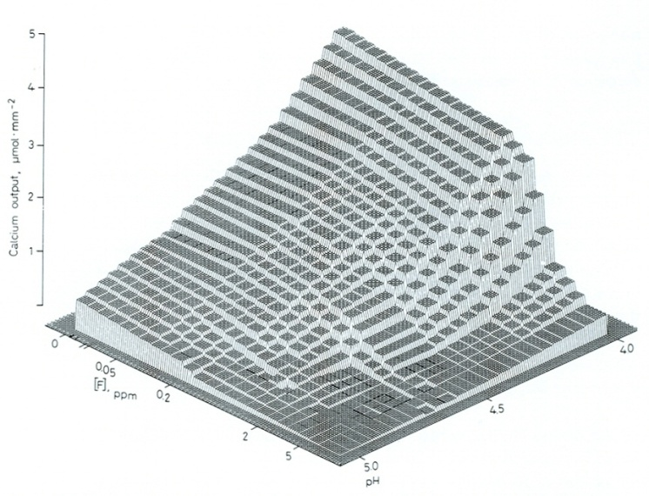
Improved crystallinity
void theory
FAP vs HAP acid solubility
Alters tooth morphology
Ten Cate JM, van Loveren C. Fluroide Mechanisms. Dent Clin N Am 1999;43:713-742.

Slide 20
Topical effects of fluoride
Bacterial metabolism and fluoride
Enzyme inhibition
Polysaccharide synthesis
Action of fluoride on Tooth surface
The desorption of proteins and bacteria
The lowering of the free surface energy
Specific plaque hypothesis
Remineralization
Increased rate of post eruptive maturation

Slide 21
Bacterial metabolism and fluoride
Action of fluoride on Tooth surface
The desorption of proteins and bacteria
The lowering of the free surface energy
Specific plaque hypothesis

Slide 22
Remineralisation of incipient lesions
Enhances remineralization
• The saliva is "supersaturated" with calcium & phosphate providing a driving force for mineral to go back into the tooth.
• The partially dissolved crystals act as"nucleators" for remineralization.
Fluoride acts to speed up this remineralization process by adsorbing to the surface & acting to bring calcium and phosphate ions together, & is preferentially included in the chemical reaction that takes place, producing a lower solubility end-product.
Featherstone JD. Prevention and reversal of dental caries: role of low level
fluoride. Community Dent Oral Epidemiol 27: 31-40, 1999.

Slide 23
Fluoride enhances remineralization
Partially demineralized crystals = nucleators
Fluoride ions adsorb to the crystal surface
Attract Ca, P new mineral formation
Enamel crystal
(Carbonated apatite)
Acid
Demin
Partially dissolved crystal
The newly formed FAP-like ‘veneer’
Ca, P, F
Remin
FAP-like
‘veneer’
Adapted from Featherstone JDB JADA 2000;131:887-99.
Crystal surfaces become less soluble
This FAP-like coating precipitated in the crystal surface, not F incorporated during tooth formation, is the major contribution to reduce enamel solubility

Slide 24
Interference with microflora
• F from topical sources is taken up by the bacteria when they produce acid, thereby inhibiting essential enzyme (enolase) activity
Featherstone JD. Prevention and reversal of dental caries: role of low level
fluoride. Community Dent Oral Epidemiol 27: 31-40, 1999.

Slide 25
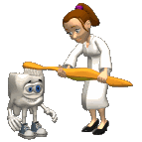
Indications for use of Topical fluorides
Caries active children
In children shortly after periods of tooth eruption
Pt. with reduced salivary flow due to medications
Those receiving radiation of head and neck
Pts with fixed or removable appliances
Disabled or alternatively abled children
Geriatric patients
After placement or replacement of restorations
Before cementation of SS crowns

Slide 26

Factors affecting uptake of fluoride
Condition of the tooth
A. Tooth age
B.Natural F conc.
C.Enamel defects
D. Dentin/cementum
Formulation of the agent
F agent
pH
C. F conc.
D. Formulation components
Application procedure
Pre-application prophylaxis
Effect of time
C. Temp
D. No. of applications

Slide 27
Professionally applied Topical fluorides

Slide 28
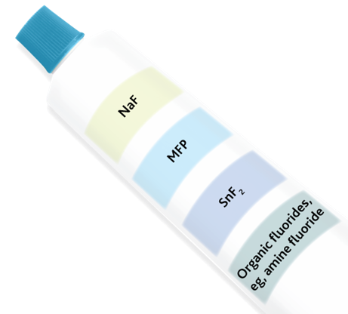
Professionally applied….
Solutions
NaF SnF₂ APF NH₂F
Gels
Varnish

Slide 29
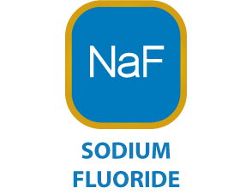
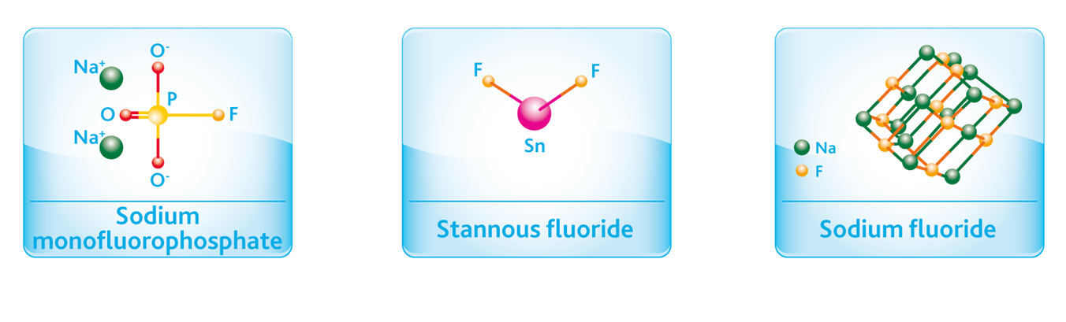
NEUTRAL SODIUM FLUORIDE
First applied topical fluoride
Bibby and Knutson 1940
Method of preparation
Technique (knutson and feldman 1948)
No. of applications
Adv and Dis adv

Slide 30
Mechanism of action
Ca₁₀(PO4)₂ + 20F⁻ 10CaF₂+6Po₄⁻+2OH⁻
CaF₂ + 2Ca₅(PO4)₃OH 2Ca₅(PO4)₃F +Ca(OH)2

Slide 31

Clinical efficacy
Author | Year | Age group | Duration of study | DMFT | DMFS
Galagan & Knutson | 1948 | 7-15 yrs | 1 yr | 22% | 14%
Howell | 1955 | 8- 15 yrs |  | 24% | 36%
Harris | 1959 | 6-11 yrs | 5 yrs | 33%
Mercer & Muhler | 1972 | 6- 15 yrs | 1 yr | 29% | 27%

Slide 32
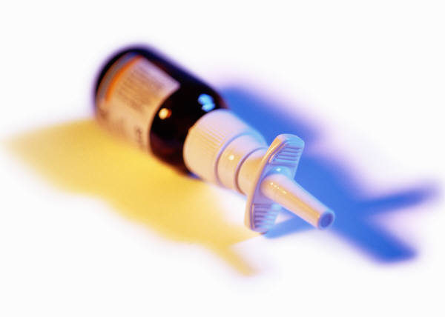
STANNOUS FLUORIDE
Second topical fluoride agent to gain wide acceptance (Muhler, 1954)
Less acid soluble than sodium fluoride (Muhlemann, 1957)
Method of preparation
Technique
No. of applications

Slide 33
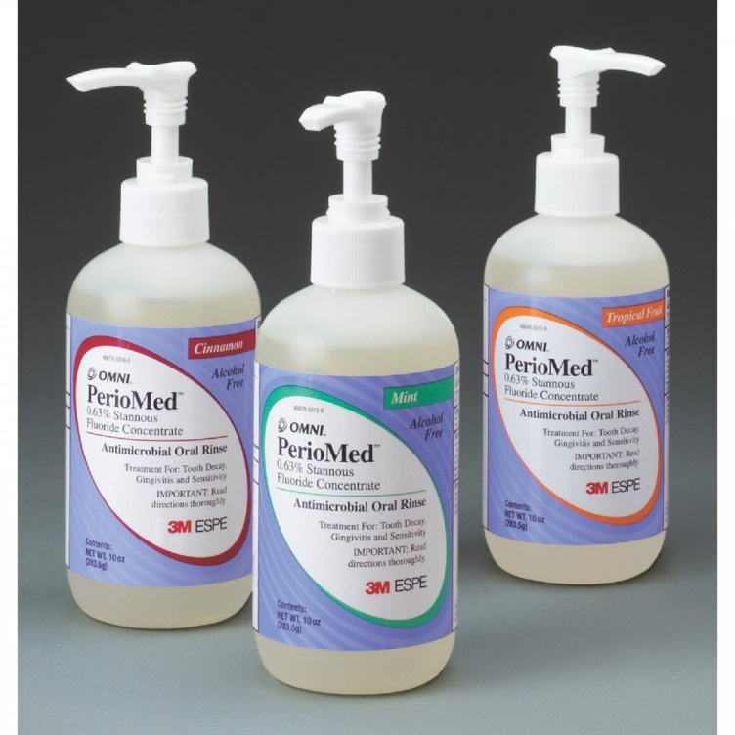
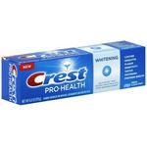
STANNOUS FLUORIDE GEL
0.4% SnF2 in a methyl cellulose and glycerine base.
Remain stable for 15months.

Slide 34
Mechanism of action
At Low conc:
Ca₅(PO4)₃OH + 2SnF2 CaF₂+Sn2(OH)PO4+Ca3(PO4)
At high conc:
Ca₅(PO4)₃OH + 16SnF2 CaF2+ 2 Sn3F3PO4+ Sn2(OH)PO4+ 4 CaF2(SnF3)2
2Ca₅(PO4)₃OH+CaF2 2Ca5(PO4)3F+ Ca(OH)2

Slide 35

Clinical efficacy
Author | Year | Age group | Duration of study | DMFT | DMFS
Law | (1961) | 7- 13 years | 1 year | 19% | 24%
Harris | (1963) | 7- 12 yrs | 3 yrs | 23%
Cons | (1970) | 6- 11 yrs | 3 yrs | 8% | 8%
Mercer and Muhler (1972) | (1972) | 6- 15 yrs | 1 yr 2 yrs | 57% 55% | 57% 57%

Slide 36
Clinical considerations
causes reversal of carious lesions (Lobene, 1966)- increase in radiodensity
Advantage
Disadvantages
        Freshly prepared
        Astringent taste
        Nausea
        Pigmentation
        Brown discoloration

Slide 37
ACIDULATED PHOSPHATE FLUORIDE
1960 Brudevold at Forsyth Dental Center
Based on fact that phosphate inhibit enamel dissolution
Preparation
Technique

Slide 38
ACIDULATED PHOSPHATE FLUORIDE GEL
Methyl cellulose or sodium carboxymethyl cellulose
pH 4- 5

Slide 39
THIXOTROPIC GEL
Displays a high viscosity at lower shear rates and very low viscosity at higher shear rates.
C. import.- the gel thins out under biting forces and more easily penetrates between the teeth.
- When it is not under stress it remains in situ in the tray and does not tend to run down the patient’s throat.

Slide 40
METHODS OF APPLICATION
PAINT ON TECHNIQUE
TRAY TECHNIQUE
Wax
Vinyl
Disposable polystyrene
Foam or
A combination of disposable material lined with foam
And a more elaborate system called Air-cushion Fluoridator with an air filled rubber tray.

Slide 41
Mechanism of action
Ca₅(PO4)₃OH + 4H⁻ 5Ca⁺⁺ +3Hpo4⁻ +H2O
Ca⁺⁺ + Hpo4_ Ca.HPO42H2O (DCPD)
Ca.HPO42H2O +F- Ca5(PO4)3F+ 2HPO4+ 3H+ +2H₂O

Slide 42
Clinical efficacy
Author | Year | Age group | Agent | Duration of study | DMFT | DMFS
Muhler | 1965 | 6- 13 yrs | 8% SnF₂+ NaH₂PO₄ | 1 yr | 66% | 67%
Horowitz | 1968,69 | 10-12 yrs | 1.2% F 0.1 M H₃ PO₄ | 1 yr 2 yrs | 17% 26% | 22% 33%
Jordan | 1969 | 6 –12 yrs | 1.2% F (NaF+HF) 0.1 M H₃PO₄ | 1 yr | 26% | 35%
Vrbic | 1974 | 10-12 yrs | 4% NaF 0.1 M H₃PO₄ | 3 yrs | 16% | 23%
Van Rijkom | 2004 |  | 1.23% |  |  | 18-70%

Slide 43
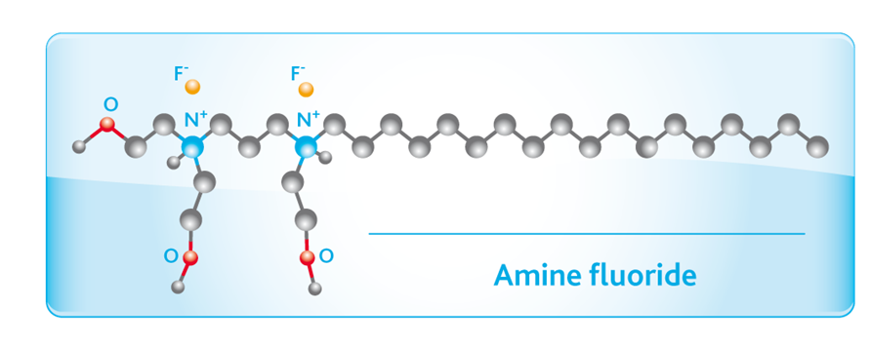
AMINE FLUORIDE
Effects of amine fluoride on enamel solubility in vitro [Zurich, Muhlemann (1957)]
Reported that – hydrofluoride of long chain aliphatic amines reduced enamel solubility to a greater extent that did by SnF2.
Chemical protection by fluoride and physicochemical protection due to organic portion.

Slide 44
FLUORIDE VARNISH
Schmidt (1964) lacquer containing fluoride
to prevent
Leaching of fluoride and calcium fluoride

Slide 45
Types
Duraphat (2.2% F) Na F
Fluorprotector ( 0.7% F) organic fluoride
Composition:
Fluorprotector: colourless, polyurethane lacquer. The F compund is a difluoosilane ( 3-methoxy- 4 hydroxy- cyclohexyl) ethyl difluorohydroxy silane in a conc.of 2% by weight. The F content is 0.7% by weight and the active F available is 7000ppm.
Duraphat is NaF in varnish form containing 22.6mg f/ml suspended in an alch.solution of natural organic varnishes. The active F available is 22,600ppm.

Slide 46
Studies..
Reducing conc. of Duraphat from 2.3% to 1.1% - no effect (Seppa, 1994)
Duraphat more effective than Fluorprotector (Seppa, 1982)
Amount of fluoride introduced by Fluorprotector (3364 ppm) more than Duraphat (4179 ppm).

Slide 47
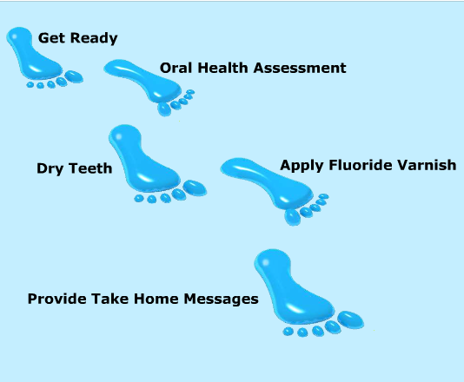
5 Steps to Applying Fluoride Varnish
Notes:
Applying fluoride varnish takes 5 Steps:
1. Get ready
2. Provide an oral health assessment
3. Dry the teeth
4. Apply fluoride varnish
5. Provide the family with take home messages

Slide 48

Clinical efficacy
Author | Year | No. of applications | Duration of study | DMFT
Hulser/ Schmidt | 1968 | one | 15 months | 30%
Maiwald/ Geiger | 1973 | two | 23 months | 45%
Murray | 1977 | two | 24 months | 36.6%
Koch/ Peterson | 1975 | two | 12 months | 75%
Tewari | 1984 | two | 12 months | 73%

Slide 49
ADA recommendations on fluoride varnishes
Fluoride varnish applied every six months is effective in preventing caries in the primary and permanent dentition of children and adolescents
2 or more applications per year are effective in preventing caries in high-risk populations
Takes less time, creates less patient discomfort and achieves greater patient acceptability than does fluoride gel, especially in preschool-aged children
J Am Dent Assoc, Vol 137, No 8, 1151-1159. 2006

Slide 50
Controversies…
Need for prophylaxis step??
No difference in pumice prophylaxis and simple toothbrushing (Tinanoff, 1974)
Plaque covered premolars; Amine fluoride and sodium fluoride – less uptake (Brunn, 1976)
No effect of prophylaxis (Johnston, 1995)
Prof. Vs Self applied??
75 – 80% reductions in DMFS using prof.applied gels, where as 30% with Self applied. (Wei 1977)
Weekly mouth rinse of 0.2% NaF clearly ranks as the most cost effective for public health purposes.

Slide 51
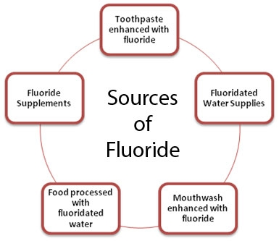
New approaches to increasing the effectiveness of Topical fluoride agents
Dual treatments
Acid etching
APF followed by SnF2

Slide 52
Self applied Topical fluorides

Slide 53
Self applied Topical fluorides
- Dentrifices
– Rinses
– Gels
– Tooth picks
– Floss
– Chewing gums

Slide 54

FLUORIDE DENTIFRICES
THERAPEUTIC FUNCTIONS
Physicomechanical
removes plaque
Chemical
Fluorapatite
resistance increases with each attack

Slide 55
DENTIFRICE (TOOTHPASTE,TP)
Pastes
Key ingredients in TP:
F salt
Abrasive
Gels:
Better interdental penetration
More acceptable to children

Slide 56
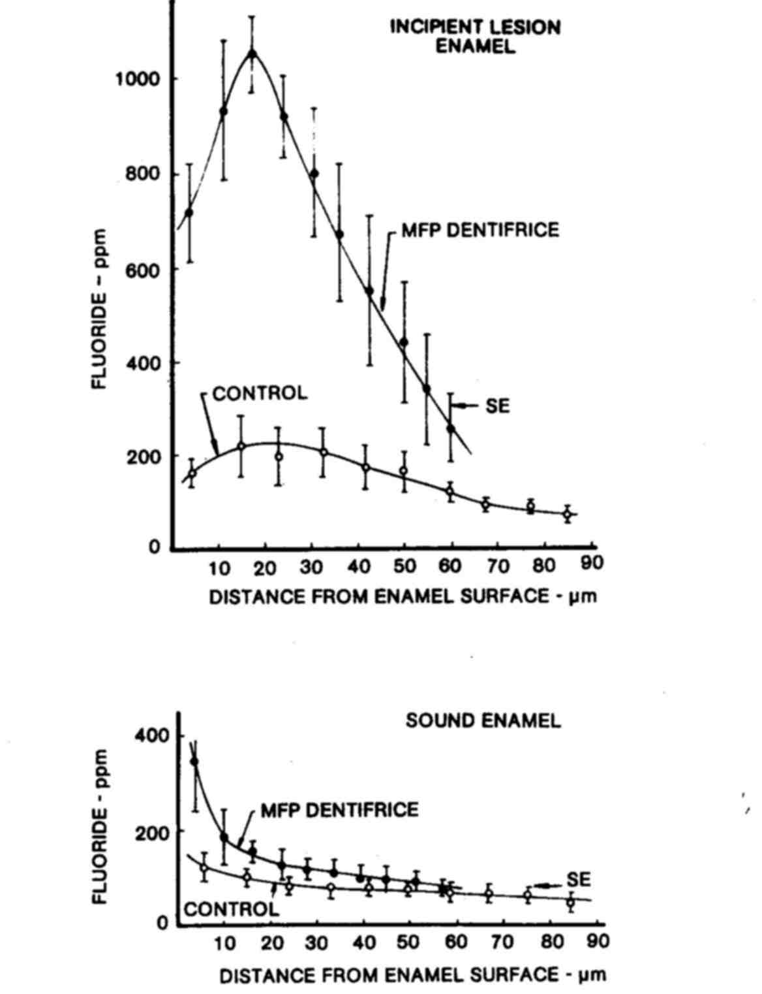

Slide 57
DENTIFRICE
F salt in TP:
MFP does not react with calcium abrasives (F is covalently bound) and has better uptake by enamel crystals.
Na
0.2% NaF
0.76% sodium monofluorophosphate (MFP)
0.4% stannous F
Amine F
PO4
F
F
F
Sn
SnF2 exhibits less shelf life and may cause dental staining
Na
1 gram of TP = 1 mg F
Amine F is not sold in the US. It adsorbs to enamel and has anti-bacterial properties
F
F
The ADA requires that 60% of free F ion be
available over the shelf life of the TP. NaF and MFP lose about 20% free F in 2 years.

Slide 58
Sodium Fluoride Dentifrice
Author | Year | Abrasive | Duration | DMFS
Muhler | 1960 | Ca₂P₂O₇ | 1 yr | 10%
Torell & Ericsson | 1966 | NaHCO₃ | 2 yrs. | 18%
Brudevold & Chilton | 1967 | DCPD | 2 yrs. | 6%
Reed | 1975 | Ca₂P₂O₇ | 2 yrs. | 20%

Slide 59
Stannous Fluoride Dentifrice
Muhler 1950s Indiana University- CREST
Ca₂P₂O₇ used
1% SnP₂O₇ added for stabilization

Slide 60
Clinical efficacy
Author | Year | Abrasive | Duration | DMFS
Muhler | 1955 | Ca₂P₂O₇ | 1 yr | 49%
Fullmer | 1960 | IMP | 3 yrs | 30%
Brudevold | 1966 | Ca₂P₂O₇ + IMP | 2 yrs | 25%

Slide 61
Sodium monofluorophosphate dentifrice
Greater compatibility with abrasives
Lack of tooth staining
pH close to 7
Ionic fluoride concentration increases with age
More effective than SnF₂ dentifrice (Finn, 1963)
6% as F– 115 ppm

Slide 62
Clinical efficacy
Author | Year | Abrasive | Duration | DMFS
Kinkel | 1974 | DCPD | 3 yrs | 17- 38%
Ashley | 1977 | DCP | 1 yr | 21%
Peterson | 1979 | CaCO₃ IMP | 3 yrs 3 yrs | 20% 0%
Naylor | 1979 | CaCO₃ | 3 yrs | 23%

Slide 63
Amine Fluoride Dentifrice
Marthaler (1968) – 32% reduction
Patz & Naujoks (1970)- 7% reduction
Ringleberg (1979)-
Amine Fluoride- 18%
Stannous Fluoride- 17.8%
Solution Amine Fluoride – 22.4 %
Sodium Fluoride rinse- 23.4%

Slide 64
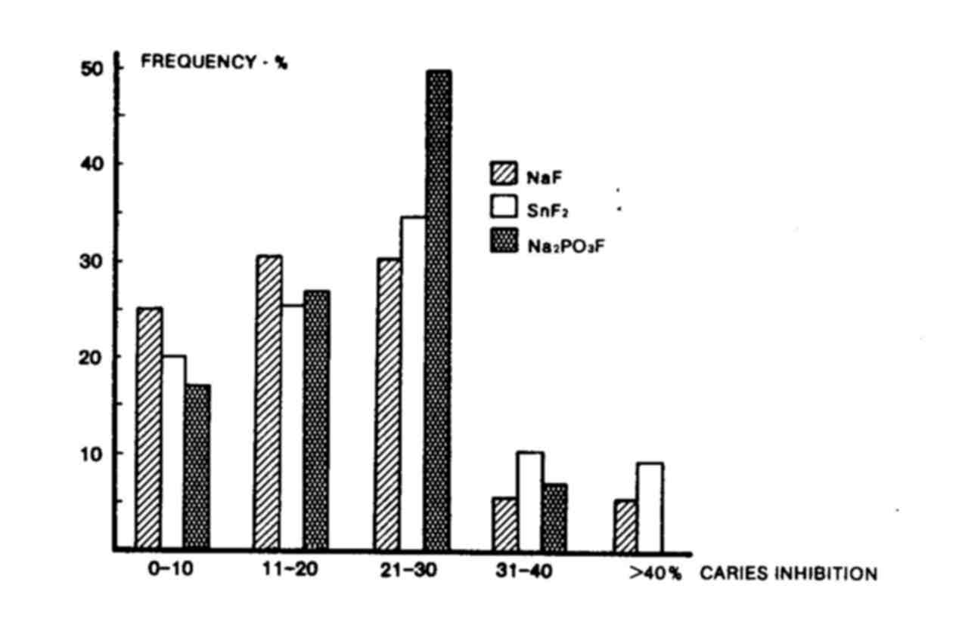

Slide 65
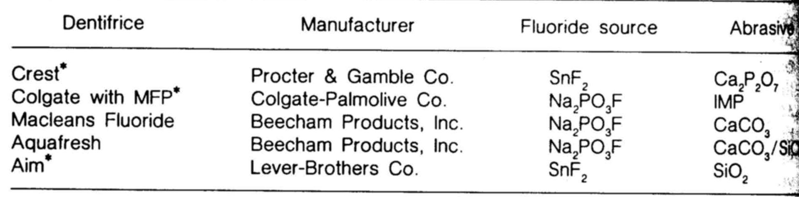
Dentifrices accepted by ADA

Slide 66

Recommendations for the use of F⁻ tooth paste
For children – below 4 yrs: F tooth paste not recommended,
For children 4-6 yrs: Brushing ones daily with F tooth paste , 2times without a paste,
6-10yrs: twice daily with F tooth paste, once without paste,
Above 10yrs: 3times with F tooth paste.

Slide 67
Self Applied Topical Fluorides….
Tooth brushing
Mouth rinsing
F gels
F tablets

Slide 68
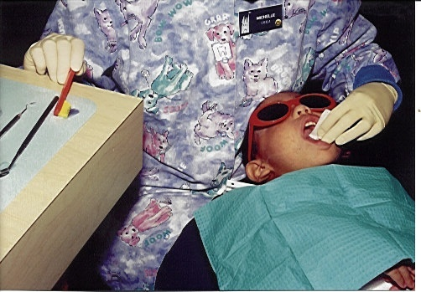
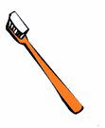
TOOTHBRUSHING
Author | Year | Agent | Frequency | Duration | DMFS
Berggren & Welander | 1964 | 0.5% NaF | 5 times/day | 2 yrs | 29%
 |  | 0.5% NaF | 2 times/day | 2 yrs | 17%
 |  | 0.5% FeF₃ |  | 2 yrs | 33%
Marthaler and Muhlemann | 1970 | NaF |  | 1 yr | 34-23%

Slide 69
Fluoride containing prophylaxis pastes
Author | Year | Agent | Duration | DMFT | DMFS
Muhler | 1970 | 9%SnF₂- ZrSiO₄ | 1yr | 41% | 60%
Muhler | 1976 | SnF₂- alkali aluminum silicate | 1 yr | 31% | 33%
Mellberg | 1978 | APF-SiO₂ | 3 yrs | 14% | 21%

Slide 70
Brushing in optimally fluoridated community
Author | Year | Agent | Duration | DMFT
Goaz | 1963 | 6% MFP | 14 months 21 months | 42% 47%
Lang | 1970 | 9% SnF₂- ZrSiO₄ | 18 months | 38%

Slide 71
HOME GELS
GEL-CAM –
0.4% SnF2,
0,097% free F,
970 ppm F, 2-3mg
F/ dose.
Indications:
Severe caries
Root caries
Prevention programs
PREVIDENT –
1.1% NaF, 0.5% free F, 5000 ppm, 10-25 mg F/ dose.
Radiation caries

Slide 72
Fluoride gel
Author | Year | Agent | Duration | DMFT
Marthaler | 1970 | 1.25% F from NaF and amine fluoride | 3 yrs | 34-40%
Horowitz | 1974 | APF gel | 3 yrs | 19%

Slide 73
Mouthrinsing
1960 s Scandinavian countries
1975 ADA accepted neutral NaF and APF as effective agents

Slide 74
Mouthrinsing
Preparation
Advantages
consistent
easily accomplished
well accepted
non-dental personnel supervise
minimal classroom time required

Slide 75
Fluoride concentrations of mouthrinses
%NaF | %SnF₂ | %NH₄F | %F | F ppm
0.01 |  |  | 0.0045 | 45
0.04 |  |  | 0.0180 | 180
0.10 |  |  | 0.0450 | 450
0.20 |  |  | 0.0900 | 900
 | 0.04 |  | 0.0097 | 97
 | 0.10 |  | 0.0243 | 243
 |  | 0.20 | 0.1027 | 1,027

Slide 76
Acidified Sodium Fluoride Rinses
Author | Year | Agent | Frequency | DMFT
Packer | 1973 | 0.66% NaF,APF | Once/ week | 41%
Finn | 1975 | 0.02% NaF, APF | Twice/day | 29%

Slide 77
Neutral Sodium Fluoride Rinses
Author | Year | Agent | Frequency | DMFT
Torrel and Erricson | 1965 | 0.2% NaF | Once/ 2 weeks | 21%
Torrel and Erricson | 1965 | 0.05% NaF | Once/ day | 49%

Slide 78
Effect on Different Tooth Surfaces
Author | Year | Agent | Frequency | Occlusal | Buccolingual | Proximal
Ripa | 1980 | 0.2% NaF | Once/ week | 20% | 15% | 40%

Slide 79
Safety of Fluoride Mouthrinses
*Ericsson & Forman (1970)
7-8ml rinse for adults
5ml for children ( 6-15yrs)
Burrell (1983) – rinse should not be used in children under 6yrs of age.

Slide 80
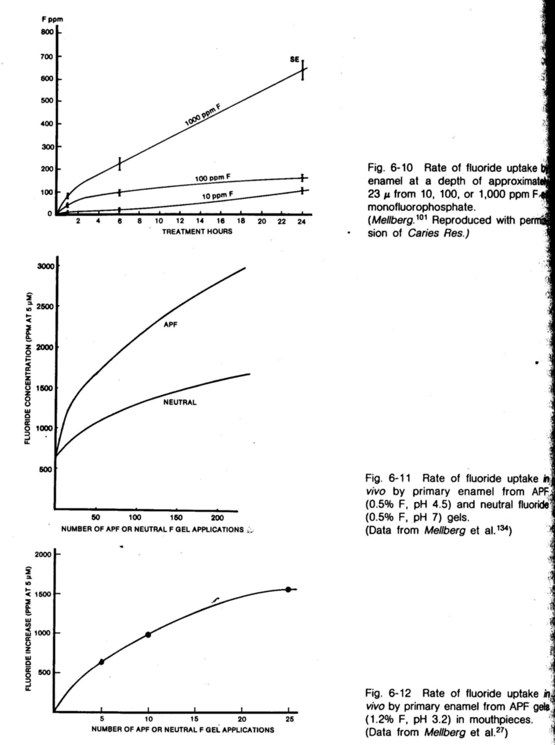

Slide 83
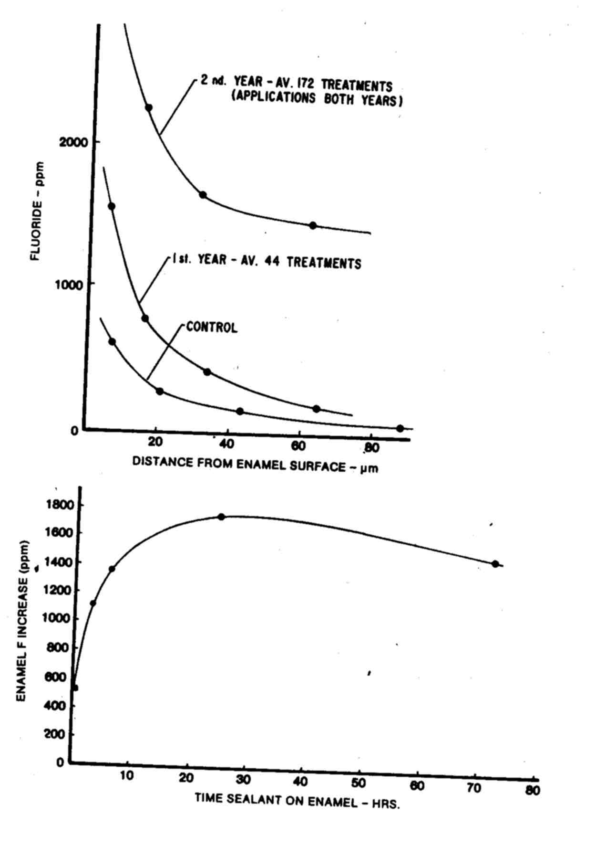

Slide 84
FLUORIDE CONTAINING
DENTAL MATERIALS
GIC – matrix of GIC consists of sheathed droplets of calcium fluoride in a siliceous hydrogel.
SILICATE CEMENT
130,000 ppm F incorporated
3000 retained in enamel (Hallsworth, 1969)
AMALGAM
SnF₂ ,CaF₂ - (Jerman, 1970)
ZINC PHOSPHATE
SnF₂ , NaF –(Wei, 1971)
SEALANT
F application never before sealant application- (Pugnier, 1972)
CaF₂ globules formed (Skehkoleslam, 1972)
F CONTAINING ALGINATE
Hottab and Frostell (1978) 1.9% F to Zelgan and kerr Alginate

Slide 85
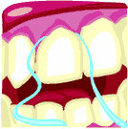
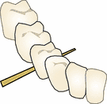
FLUORIDE IMPREGNATED DEVICES
DENTAL FLOSS
*S.mutans number decreased
*S.mutans adherence decreased
*NaF Floss- 30%; SnF 39 % reduction (Gisselson, 1999)
*elevated conc. (Sarner, 2003)
PROPHYLAXIS CUP
*increased temperature – enhances uptake (Mellberg, 1972)
* thermoplastic cup- blend of resin+ NaF+SnF₂

Slide 86

RECENT ADVANCES IN FLUORIDE RESEARCH

Slide 87
Slow releasing Fluoride devices
Intraoral fluoride releasing device
The glass bead,
Use of F complexers,
Use of fluoride containing polyelectrolytes
Role of surface active agents
Self gelling liquid fluoride
Combination of F and CHX
Type which consists of a mixture of sodium fluoride (NaF) and hydroxyapatite.
Iontophoresis

Slide 88
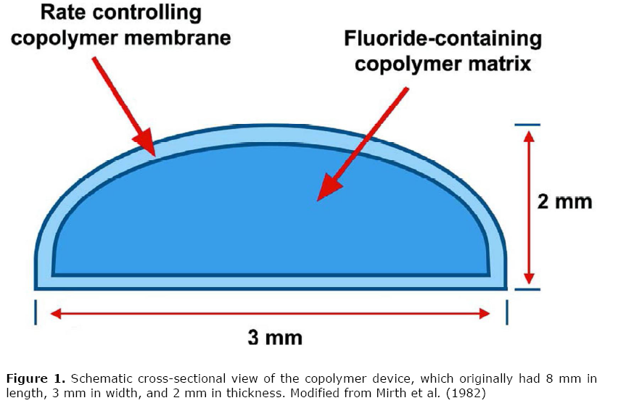
1. Intraoral fluoride releasing device
JADA, Vol. 129, September 1998

Slide 89
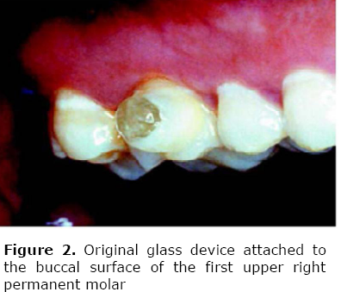
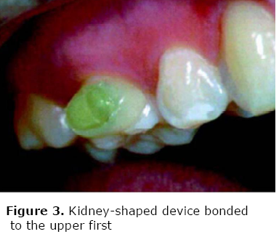
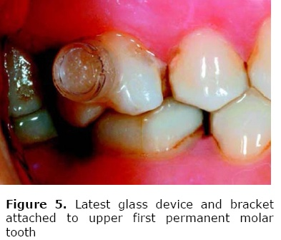
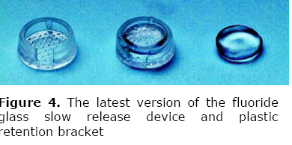
2. The glass bead
J Appl Oral Sci 2008;16: 238-44.

Slide 90
3. Use of F complexers
Al and Ti metals.
Al- 0.5 M Al.nitrate
Ti- 1% TiF4 (Shrestha et al 1972)
Reed and Bibby (1976) – 50% caries reduction with 1%TiF4 ; 33% only with APF.
J Appl Oral Sci 2008;16: 238-44.

Slide 91
4. Use of fluoride containing polyelectrolytes
Bartels et a (1982) – poly 4- vinyl pyridine.
J Appl Oral Sci 2008;16: 238-44.

Slide 92
5. Role of surface active agents
Wettary of SAA - affect the wettability – lowering S.T of F solution leading to its increased spread and penetration in the tooth surface.
Eg: Cetyl pyridinium chloride,
Decyl β- D- glucopyranoside
Lodyne s- 110
J Appl Oral Sci 2008;16: 238-44.

Slide 93
6. Self gelling liquid fluoride
Caslavaka and Gron (1984) - Tetraethoxysilane (TES), water, electrolytes, surfactants..
Polymer and Ethanol
Increase phase contact and gelation.
J Appl Oral Sci 2008;16: 238-44.

Slide 94
7. Combination of F and CHX
Combination have the potential to inhibit carbohydrate metabolism at diff. sites
Inhibits S.mutans and S. sanguis
J Appl Oral Sci 2008;16: 238-44.

Slide 95
8. Hydroxyapatite - Eudragit RS100 diffusion controlled F-system
This is the newest type of slowrelease F device, which consists of a mixture of hydroxyapatite, NaF and
Eudragit RS100; it contains 18 mg of NaF and is intended to release 0.15 mg F/day.
It was demonstrated that the use of this device is able to
significantly increase salivary and Urinary F Concentrations for at least 1 month
JADA, Vol. 129, September 1998

Slide 96
9. Iontophoresis
It is based on that – a small amount of current will help drive fluoride ions further in to dental enamel, producing the desire effects (e.g., reduced enamel solubility, increased FAP formation, reduced dentin sensitivity, even sterilization of root canals)
Applications :-
In the treatment of hypersensitive root surfaces
To increase F uptake by dental enamel
For endodontic purposes

Slide 97
Guidelines for Calculating the Quantity and
Concentration of Fluoride
Ion in Fluoride Compounds

Slide 98
Introduction
--Why do we calculate the Fluoride Ion?--
Fluoride by “nature” is a very active element. Its active nature will not allow it to be found in its pure form. As a result, fluoride combines with other elements to form fluoride compounds. We have to calculate the amount of fluoride ion in each compound in order to:
  Compare the strength of different fluoride compounds by knowing the concentration of fluoride ion in each compound.
  Calculate the exact amount (“quantity”) of fluoride ion ingested in case of accidental ingestion of any fluoride compound.

Slide 99
--What are the Risks of Ingesting More than the Recommended Dose of Fluoride?--
In contrast to the desirable anti-cariogenic effect of fluoride, it is also a toxic substance. Acute ingestion of fluoride in large quantities may be followed by rapidly developing signs and symptoms, which may result in death. When it is ingested in relatively small amounts during the period development, it may produce changes in the quality and appearance of enamel (fluorosis). When somewhat larger amounts are ingested over a period of years, changes in the quality and the quantity of the skeleton may occur. This, in fact, is the basis of the use of fluoride ion for the treatment of osteoporosis.

Slide 100
Important Information Before Any Calculation
Percentage “%” means parts per hundred (pph) | Percentage “%” in fluid means gram per 100 ml
1 ounce = 28.4 grams 8 ounces = 227.2 grams | “ppm” means parts per million ppm = 10,000 x pph “%”
Atomic Weights: Na = 23 F = 19 Sn = 119 P = 31 O = 16 | Example: NaF 23+19 = 42 19/42 = .45 or 45%

Slide 101
Calculation of Fluoride Ion in Fluoride Compounds
2. Calculate the Ratio of Fluoride Ion
This ratio is the key factor for all of the calculations of fluoride. It is the result of the atomic weight of fluoride multiplied by the number of fluoride atoms in the compound divided by the total molecular weight of that compound.
For example: NaF has a ratio of .45 of fluoride ion. This 0.45 is equal to 19/42. “19” is the atomic weight of one fluoride atom. “42” is the molecular weight of the compound.

Slide 102
Calculation of Fluoride Ion in Fluoride Compounds
Multiply
Multiply the calculated ratio by the percentage, ppm, or the weight of the fluoride compound to get the percentage, ppm, or the weight of the fluoride ion in that compound.

Slide 103
Calculation of Fluoride Ion in Fluoride Compounds
Example:
How much F is in 10 ml of Fluorigard mouth rinse?
1. Fluorigard has 0.05% NaF (from the label). From the percentage given 0.05 gram of NaF per 100 ml
= 50 milligram of NaF per 100 ml
= 5 mg of NaF per 10 ml
2. The ratio for NaF is 0.45
3. Multiply
-If we are interested in concentration of fluoride ion, then we multiply the percentage of the compound (0.05%) by the ratio. 0.05% x 0.45 = 0.0225% fluoride ion (concentration in % pph); To get the ppm, multiply 0.0225 % x 10,000 = 22,500 ppm of fluoride ion in Fluorigard mouth wash
-If we are interested in weight or the quantity (as the example requested), then we multiple the weight of the compound in “mg” by the ratio; 5 mg x 0.45 = 2.25 mg of fluoride in 10 ml of Fluorigard mouth wash

Slide 104
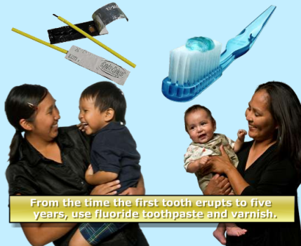
ADA/AAP Dietary fluoride supplement schedule based on fluoride ion level in drinking water (ppm)
Age | Less than 0.3 ppm | 0.3 – 0.6 ppm | Greater than 0.6 ppm
Birth – 6 mo | None | None | None
6 mos – 3 yr | 0.25 mg/day | None | None
3-6 yrs | 0.50 mg/day | 0.25 mg/day | None
6-16 yrs | 1.0 mg/day | 0.50 mg/day | None
1 part per million (ppm) = 1 milligram/liter (mg/L)
2.2 mg sodium fluoride contains 1 mg fluoride ion.
Committee on Nutrition, American Academy of Pediatrics. Fluoride supplementation for children: interim policy recommendations. Pediatrics 1995, 95(5):777.

Slide 105
CONCLUSION

Slide 106
References
Fluorides and Dental caries- AMRIT TEWARI
Fluoride in Dentistry- OLE FEJERSKOV
Pediatric dentistry- STEWART
Pediatric dentistry: STEPHEN WEI
Essentials of preventive and community dentistry- SHOBAN PETER

Slide 107


